Slide 1
S|A 3 Background

Slide 2


Background
Sapient|Approach (S|A) defines the delivery model used to create success for our clients over the last 15 years
  Methodology
  Team structure and organization
  Distributed delivery - work anywhere, anytime
  Standardized tools and techniques
Based on Agile principles:
  Iterative
  Evolutionary design instead of “big upfront design”
  Embraces the reality that requirements change over time
  Working software (or completed deliverables) is the primary measure of progress
  Self organizing teams
  Focus on process automation
  Client collaboration, visibility and control

Slide 3
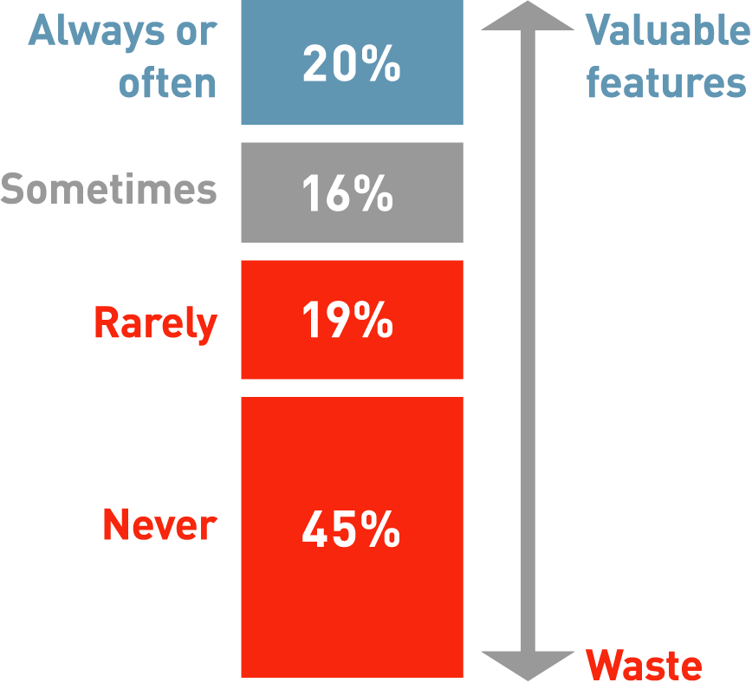

Potential in Market for Creating Value
The Standish Group reports that nearly two-thirds of the features built are rarely or never used, in other words, waste
The root cause of this waste is fundamentally driven by the way that we engage with our clients!
Notes:
Speaker notes:
The point of this slide is that we followed our processes but the result was something that was not valuable to our clients. The team committed to doing something, they delivered it, and one of 2 things happened: (1) The client saw the application during UAT, and realized that what was built was not exactly what the client had met, or (2) the business had changed and this was not reflected in what the client saw. We are hoping that with S|A 3, this problem will go away, or at the very least decrease significantly.

Slide 4

Why are we doing S|A 3?
Improve predictability for our clients and teams
  Checkpointing much earlier and more frequently with clients
  Providing platform for metrics program to support our teams in planning/estimating
Maximise value to our clients
  Allowing scope to be refined (swapped) throughout project life cycle resulting in change in client‘s business priorities and reducing risk
Reduce risk on our engagements
  Addressing high risk components first and validating them with the client sooner
Ability to scale the organization
  Driving consistency in the way we do projects across the organisation
Increase sustainability
  Being able to detect and address problems earlier
Accelerate new hire integration
  Using industry standards as well as offering a robust training program
Improve communication and relationships with our clients
  Delivering working code to our clients much earlier and responding to changes/feedback

Slide 5
S|A 3 Key Assumptions
We seek to provide maxiumum value to our clients
We are solving extremely complex problems for our clients
We are striving for long term deals with our clients
GDD is the world in which we operate

Slide 6
What work is covered by S|A 3?
Projects covered under S|A 3
  Plan, Create and Manage Projects with revenue greater than 300K USD
Some areas are not relevant
  Staff augmentation
  Areas where we are a sub-contractor to another firm with formal processes
Future focus areas for the S|A 3 team:
  Pure Testing
  SAP
Notes:
Note not mandatory does not mean that you cannot use it, just that it’s harder.

Slide 7

Sapient|Approach 3 Basics

Slide 8
Sapient|Approach 3 Basics
S|A 3 Overview
Delivery Model

Slide 9

EAR: Executable Architecture Release Definition
Sapient|Approach 2 (waterfall)
Fusion
Design Phase
Implementation Phase
Manage
Sapient|Approach 3
Fusion
Exec. Architecture Release (EAR)
Release 2
Release 3
Manage
It 1
It 2
It 3
It 4
It 5
It 6
It 7
It 8
It 9
It 10
It 11
It 12
EAR is the first release of a project where:
  10-20% of the application is built and tested
  Requirements are gathered and documented at varying degrees of detail depending on risk and complexity
For a FT/FP engagement, during the EAR the minimum amount of work is done in order to be able to provide a solution and determine a FT/FP for the remainder of the project
Notes:
Speaker notes:
The key point to make here is that we don‘t just rely on paper work…we start to actually build the application. This is the best way to prove that a design is a good design.
If people push back and say that they do not have access to any development environments so early in the project, then it is not possible to start coding, we would request a deviation in this case.

Slide 10
Ongoing Releases Definition
Sapient|Approach 2 (waterfall)
Fusion
Design Phase
Implementation Phase
Manage
Sapient|Approach 3
Fusion
Exec. Architecture Release (EAR)
Release 2
Release 3
Manage
It 1
It 2
It 3
It 4
It 5
It 6
It 7
It 8
It 9
It 1
It 2
It 3
Ongoing releases focus on delivering functionality based on business value
EAR focuses primarily on mitigating risk while subsequent releases focus on delivering functionality prioritized by business value
Ongoing releases may be deployed to:
  Client QA environment
  Client production environment
Notes:
Speaker notes:
While the EAR prioritises based on risk, and once the EAR is in place it is assumed that the architecture is stable, for subsequent releases the functionality that will be built can be prioritised by business value.
Note also that releases may not entail deployment to a production environment. It may only be a deployment to the client QA environment.

Slide 11
Iteration Definition
Sapient|Approach 3
Fusion
Exec. Architecture Release (EAR)
Release 2
Release 3
Release 4
It 1
It 2
It 3
It 4
It 5
It 6
It 7
It 8
It 9
It 10
It 11
It 12
Go Live
Iteration N
Mon: Iteration kick-off with client
Mon
Local team: acts as interface to client, does some dev work
Fri
GDD team: develops and tests `
Fri: End-of-iteration checkpoint with client
An iteration is a 1-4 week time-boxed period:
  Produces a small, tested, integrated subset of the solution
  Produces potentially deployable functionality
  Functionality is validated by clients and used as feedback for the next iteration
“Deployable” can mean:
  UAT deployment to an internal QA environment
  Limited-access “friends and family” production deployments
  Full-scale production deployments for commercial use
Notes:
Speaker notes:
Point out that potentially deployable refers more to the quality. It does not mean that we are mandating that code be deployed, rather that the quality of the code is at a high standard. And that means no P1s or P2s at the end of the iteration.
Also point out that there will more than likely be iterations early on where no code is produced. We are not following an XP model where teams get in there and start coding withouth thinking about the overall design. We start broad, think about hte overall approach, and then go deep.

Slide 12
Use Case Definition
A use case is a technique for capturing the potential requirements of a new system or software change
Each use case provides one or more scenarios that convey how the system should interact with the end user or another system to achieve a specific business goal
Use Cases consist of the following characteristics:
  Actors: entities outside of the system that interact with it to perform a process
  Pre-conditions: characteristics visible to the actor that must be satisfied for the use case to perform successfully
  Post-conditions: the different states in which you expect the system to be in after the use case executes successfully
  Event flow: description of how the actor together with the system achieves the desired task
  Extensions: alternative flows resulting from conditions deviating from those described in the basic event flow; a use case may have many extensions
  Rules: business rules encapsulating the behavior of the system in reaction to specific conditions
  Constraints: non-functional requirements that constrain the use case
Notes:
Note:
If you want to show the Use Case templates, click on the links.
Note that these templates will in future releases of RS be built into the online RS Planning Tool. Until that point teams need to use these templates.

Slide 13
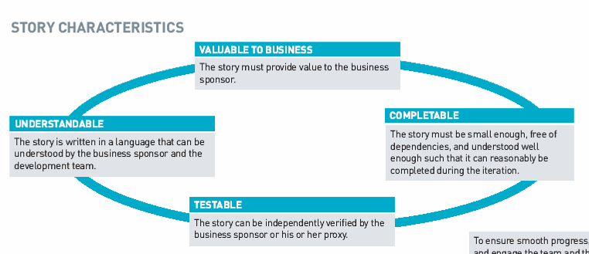
Story Definition
A story is the fundamental unit of work and the primary unit of planning, execution and communication between client and the team
Notes:
Speaker notes:
Emphasise the fact that a story is really a way of breaking down work into smaller more manageable pieces.
Re-iterate that early on in the project, many stories may be paper based to document the breadth of requirements.
Ask participants for examples of what a good or bad story is.

Slide 14
Story Points
Story points = ABP for a story
Story size is a planning construct that enables us to predict how much a team will be able to complete in each iteration
Story size is used to estimate how many iterations will be needed to complete all stories in the current release, what date the project will be done etc.

Slide 15
Stories as part of Iterative development
High-level Analysis and Design (identify key features)
Story 1
Story 2
Story 3
Slices cut across all sub-systems
Presentation / User Interface
X
Business Logic / Services
Database / Integration
Horizontal development, by contrast, defers integration, resulting in downstream architectural consistency and integrity issues
2-May-05
30-May-05
27-Jun-05
25-Jul-05
22-Aug-05
19-Sep-05
17-Oct-05
14-Nov-05
12-Dec-05
Iteration 1
Iteration 2
Iteration 3
Iteration 4
Iteration 5
Iteration 6
Iteration 7
Iteration 8
Data generated and used to calibrate the plan
EAR
Release
Notes:
Speaker notes:
The left hand side illustrates how stories cut across all layers.
The right hand side illustrates that if we develop horizontally (as we do today), more often than not, this leads to integration issues which are often not resolved or even detected until stabalisation.

Slide 16
Story Examples
Which are good stories and which are bad?
  User can use hotel website
  User views hotel search results with no hotels
  User views list of hotels based on input location (no date, #rooms, guests specified)
  Evaluate, select and install automated testing tools
  System uses Log4J to log all error messages
  Model hotel booking workflow
  Develop vendor API proof of concept (spike)
  Document test plan
  Graphing and charting shall be done using Business Objects
  User configures the number of hotels displayed on the page
  Model document management use cases
  User exports the hotel information to Microsoft Word
  Document hotel availability rules
  Develop the persistence framework
  Develop the hotel details view JSP

Slide 17
Answers
  User can use hotel website. BAD
  User views a hotel list with no hotels. GOOD
  User view list of hotels based on input location (no date, #rooms, guests specified). GOOD
  Evaluate, select and install automated testing tools: GOOD
  System uses Log4J to log all error messages. BAD
  Model purchase order workflow: GOOD
  Develop vendor API proof of concept (spike): GOOD
  Document test plan: GOOD
  Graphing and charting will be done using Business Objects. BAD
  User configures the number of hotels displayed on the page. GOOD
  User exports their hotel information to Microsoft Word. GOOD
  Document hotel availability rules: GOOD
  Develop the persistence framework. BAD
  Develop the hotel details view JSP. BAD

Slide 18

A typical S|A Project Lifecycle
Sapient|Approach 3
Fusion
Exec. Architecture Release (EAR)
Release 2
Release 3
Manage
It 1
It 2
It 3
It 4
It 5
It 6
It 7
It 8
It 9
It 10
It 11
It 12
Go Live
Iteration N
Mon
Client team: acts as interface to client, does some dev work
Fri
MON: Iteration kick-off with client
GDD Team: develops and tests
FRI: End-of-iteration checkpoint with client
A project is broken into releases (a release should occur no less frequently than every 4 months)
Releases are broken into 1-4 week iterations
Notes:
Speaker notes:
The waterfall SA2 model as we know it is being replaced by an iterative development model.
Key changes:
The phases as we know them will no longer be the same. Instead a project will be broken down into releases, of which the first release is called the Executable Architecture Release.
Executable Architecture Release (EAR)
The purpose of the EAR is to do the minimum amount of work to understand the problem and commit to a solution
To achieve this each team must assess what combination of requirements, analysis, development and design activities are necessary to mitigate both requirement and technical risks associated with the project
Release Planning
A release must happen no later than every 4 months
Release lengths can be different from release to release
Work with client to identify target functionality for first release: what is their “minimal marketable feature set?”
The smallest subset of the solution’s capabilities that would have value for the client
Know that the mid-level plan will change, don’t try to get too precise
Iteration Planning
An iteration length is 4 weeks
Focus on “Done is Done” while talking about iteration planning
Deliverables must be production-ready at end of every iteration
No separate “clean up” phase
Forces decision making and closure on the things of immediate concern
Need to leave time to do closeout within the iteration

Slide 19
Project life cycle deliverables
Opportunity
Development
Fusion
EAR
Release N
Manage
Client artifacts
RFI
Client artifacts
Meeting minutes
SOW
Fusion Scope
Fusion Plan
Fusion Estimate
Project Scope
HLP
EAR Release Plan
Fusion artifacts
Release Plan
Design documents
Core functionality built and tested
Known defects and potential enhancements
SLA
INPUT
Meeting minutes
Fusion scope and/or SOW
Fusion estimate
Fusion plan
Fusion price
Vision
MBRs
Key features (high level Req.)
Scope Matrix (high level Use Cases)
Program governance (Risks Plan, Communication plan)
Validated HLP
Estimate for EAR
Price for EAR
Price range for Release 2
Release Plan for EAR
10-20% of application built and tested
Test Plan
Automated tests for EAR functionality
Use Cases
Baseline logical architecture diagrams
Baselined physical architecture diagrams
Baseline system architecture diagrams
Baseline logical/physical data model
Interface specifications
High risk/value wireframes and screen mock-ups
Release plan for Release 2
Price for follow-on releases
Implemented and tested functionality
Automated regression test suite
Client checkpoint every 4 weeks
Updated data model, external system specifications
Estimate and SOW for Manage
SLA reports
New functionality implemented and tested
Automated tests for new functionality
OUTPUT
Notes:
Speaker notes:
Mention that the ideal case is for a project to do a Fusion -> EAR -> Releases -> Manage
However there are several other variations of this, and one that we often see is RFP -> Releases -> Manage
It is still required that the project defines the artifacts that would typically be output from a Fusion, even if there is no Fusion.

Slide 20
A typical Manage Project
Defects and Enhancements
Release 4
Release 5
2 weeks
It 1
It 2
It 3
It 4
It 5
It 6
Support releases
Enhancement
releases
Combined defects and enhancements management
1-4 week iterations (as dictated by the Enhancements needs)
2 types of releases
  (1) Support release (planned and unplanned)
  (2) Enhancement release
Support releases to production for high priority defects occur as needed and may or may not coincide with Enhancement releases
Enhancement release to production or QA environment must occur every 4 months at the latest
Notes:
Speaker notes:
Often defect and enhancement work is managed and tracked as 1 project.
In this case you would set up the tool to support the releases, iterations as decribed abovel.

Slide 21
Sapient|Approach 3 Basics
S|A 3 Overview
Delivery Model

Slide 22

S|A 3 Iterative Delivery Model
(3) Daily team Meeting
24 hours
4 weeks
(4) Deliver potentially deployable functionality
[1] Validate / Reprioritize scope
Iteration
Plan
Potentially
Depoyable
Functionality
Checkpoint
with
client
Iteration
Scope
(2) Build Iteration Plan
Notes:
Speaker notes:
When we sit with the client we are not necessarily saying that each kickoff we need to reprioritise scope. We are showing them what was originally planned for the tuiteration, and then providing them with the option to swap scope if they feel it is necessary. It is providing this choice that is very powerful. We have seen from our pilot projects that many times, after seeing what was delivered, clients have made scope choices that they may not have if they had not seen working code. This happened in Avatar.
(1) Validate/Reprioritize scope - At the start of each iteration, the Sapient team works with the client to validate planned iteration scope and if needed reprioritise or swap scope
(2) Build iteration plan - The Sapient team works with the client to gain a deeper understanding of the iteration requirements and be able to break the work down allocated to their track. Each track uses this to create an iteration plan
(3) Daily team Meeting - The team meets daily to report status and address roadblocks
(4) Deliver potentially deployable functionality - The Sapient team performs Analysis & Design, Requirements detailing, Development and testing of the selected scope items to deliver something of value to the client at the end of each iteration

Slide 23
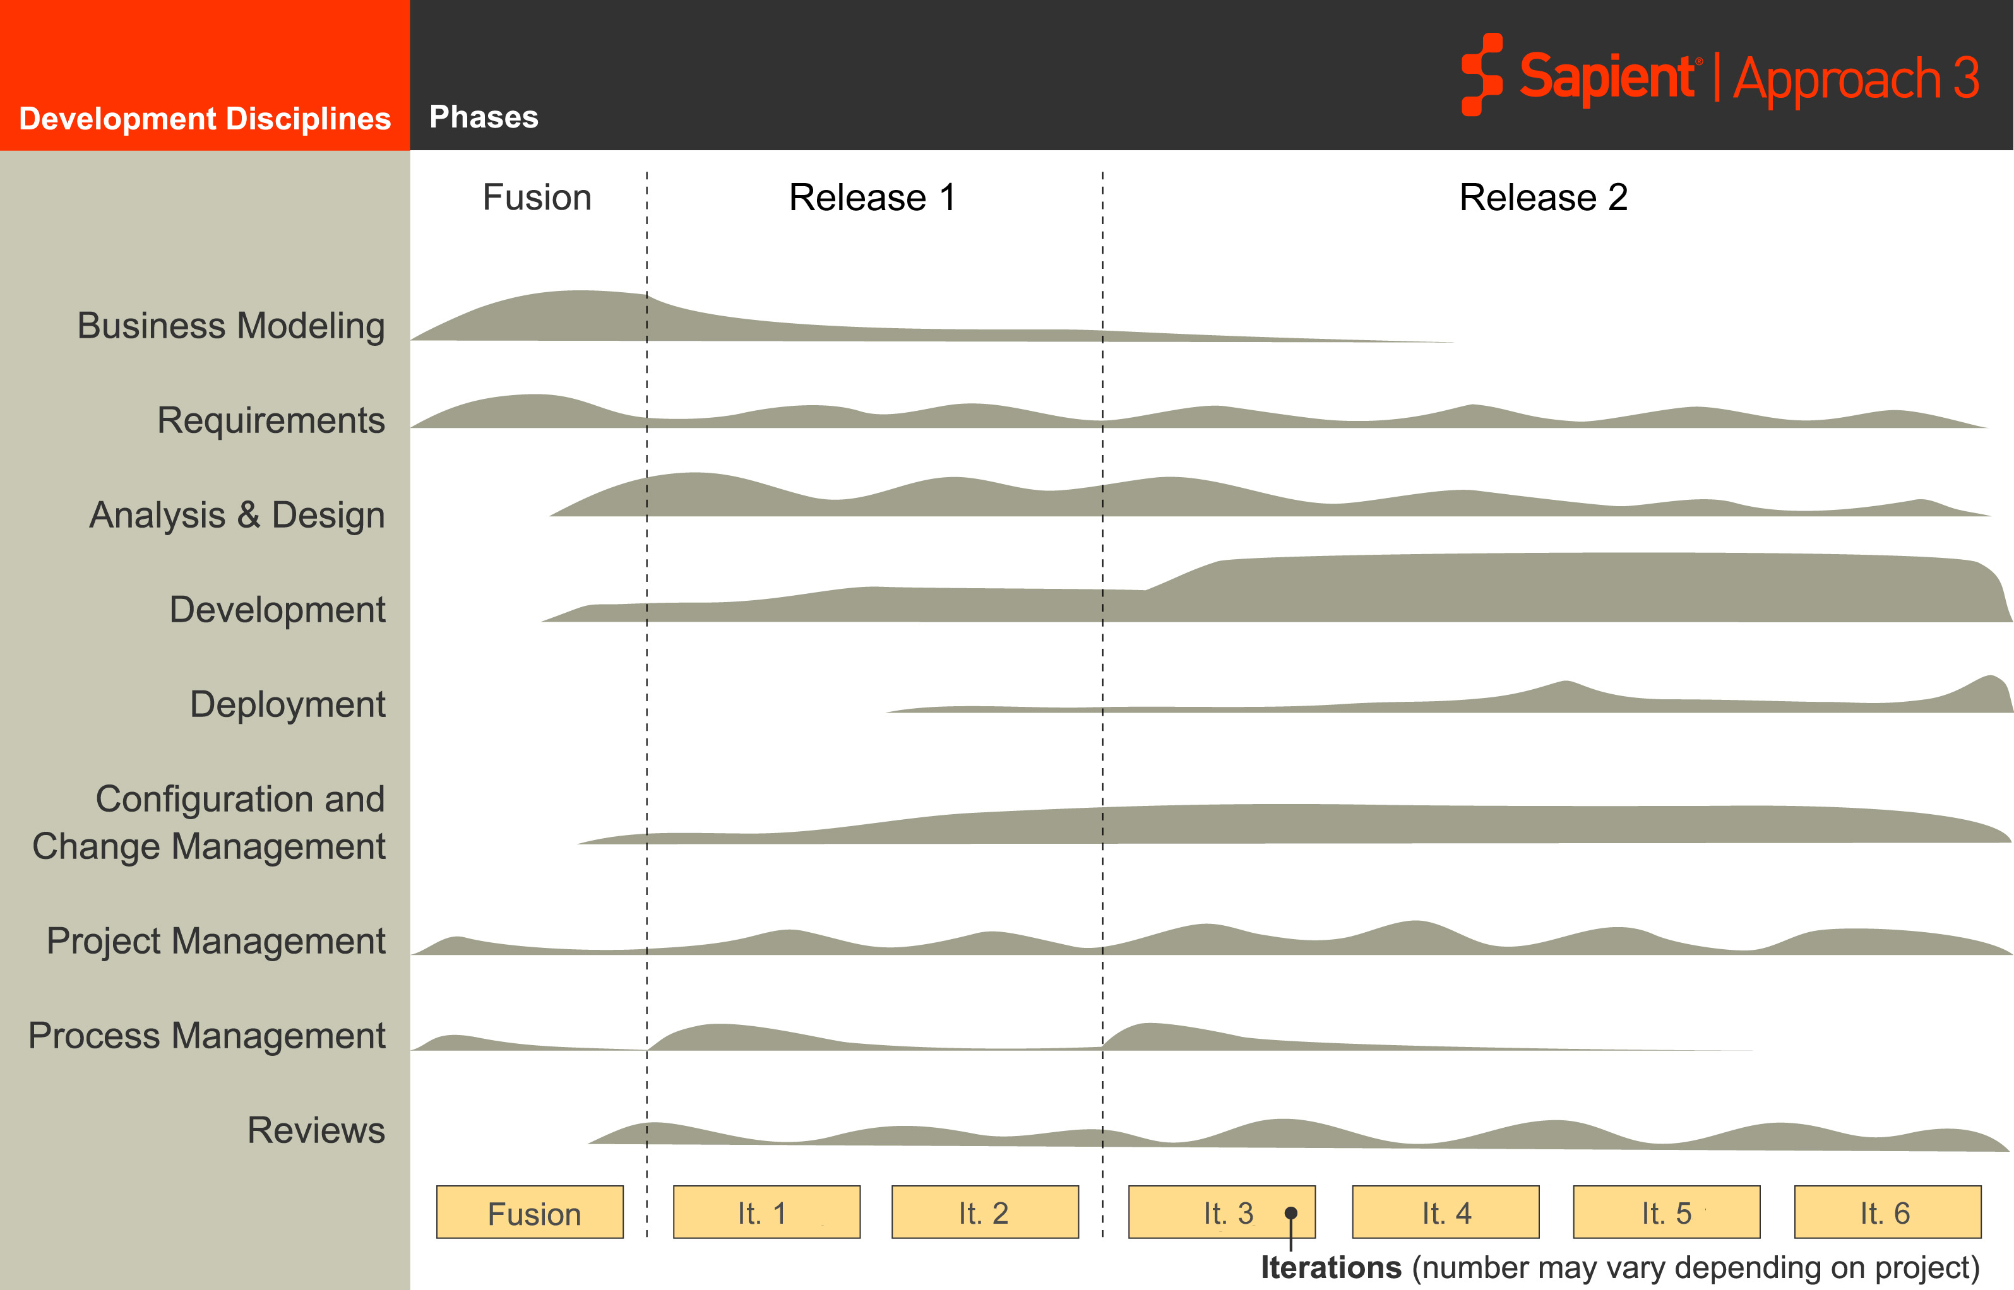
S|A 3 Project Life Cycle
Related processes are grouped into disciplines
Sapient|Approach 3
Disciplines
Fusion
EAR
Release 2
It 1
It 2
It 3
It 4
It 5
It 6
Requirements, Analysis & Design, Development and testing occur throughout the project life cycle
Notes:
Speaker notes:
Persons familiar with Unified Process (RUP) will almost immediately recognise this diagram and are likely to draw comparisons and challenge how S|A is different from RUP. If people are interested, you can talk to the fact that the Requirements discipline is almost directly from RUP.
Point out that in this training, we will not be covering all the differences between RUP and other methodologies in this training, but we have extensive material that points out the differences which if requested we can share with people.

Slide 24
Example: Iteration Discipline Breakdown
2-May-05
30-May-05
27-June-05
25-Jul-05
22-Aug-05
19-Sep-05
17-Oct-05
14-Nov-05
12-Dec-05
Iteration 1
Iteration 2
Iteration 3
Iteration 4
Iteration 5
Iteration 6
Iteration 7
Iteration 8
EAR
Release 2
Analysis & Design
Modelling
Spike/POC
Development

Slide 25
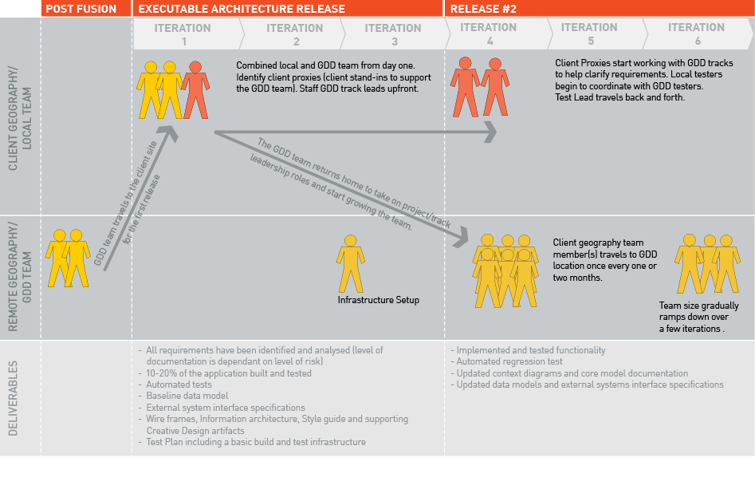
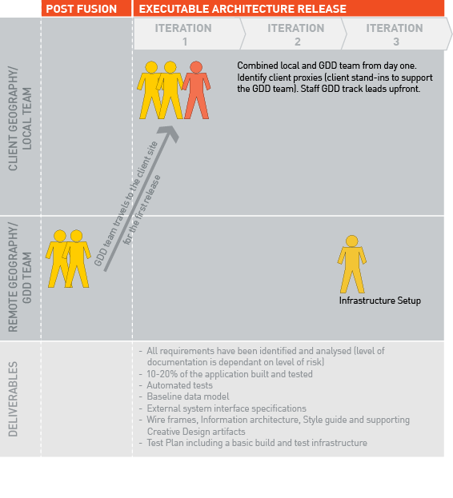
Distributed delivery
Notes:
Speaker notes:
This slide builds.
Key messages
The first few iterations are based at the client geography (including key team members from India)
They then travel back to India and the local people stay at the client geography
Note that the client leadership needs to travel to India once a month or so.

Slide 26
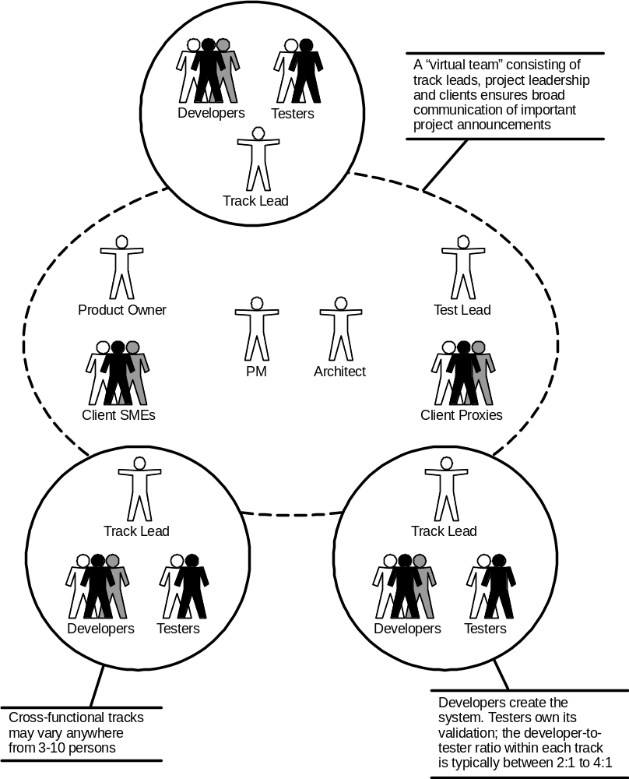
Team Structure
Notes:
Speaker notes:
Point out that the client proxy is a role played by a Sapient person at the client site in addition to their assigned project role. It is not given to a person who is playing the client proxy role and nothing else.
Historical S|A team structure remains
PM/Arch partnership
Work is divided among tracks headed by Track Leads
What’s new?
Tester
Dedicated testers assigned to each track (ratio typically ranges from 2:1 to 4:1)
Test Lead
Project leadership level role responsible for organizing and planning testing efforts
Mentors testers
Client Proxy
Client site Sapient role that helps remote teams clarify requirements and run issues to ground
Typically the Sapient PM at the client site will play this role
Product Owner
Client owner who participates in Kick-offs and Iteration closures, as well as provides feedback

Slide 27
Questions?

